Slide 1
Enhancement program
LED Buttons Servos LCD H-bridge Interrupts

Slide 2
Using LEDs with arduino
Why should I use resistors with LEDs?
LEDs do not behave like resistors. The current through a resistor varies proportionally with the voltage.
But when an LED is connected to a power supply, it draws excess current and burns out.
To limit the amount of current flowing through the LED, a ballast resistor is hooked up in series to the resistor.
Specifications of an LED:
Specification | Range
Forward voltage | 2.1V to 3.6V depending on the colour of the resistor
Forward current | 10 mA to 30 mA
Operating temperature | Especially important for high power LEDs

Slide 3
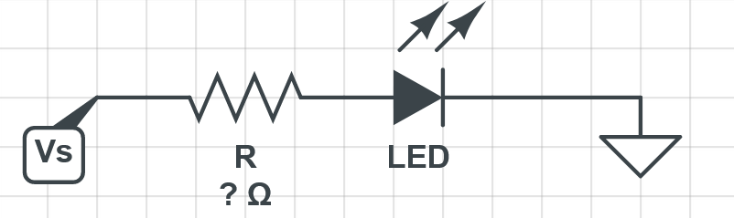
Using LEDS with arduino
Data that you need:
Current consumption of the LED
Voltage drop of the LED
Supply voltage ( 5V here)
Colour | Voltage drop
White | 2.2
Blue | 3.6
Red | 2.0
Yellow | 2.1
Green | 2.1
R = V_{s} – V_{led}
Most LEDs draw between 10 to 30 mA
I

Slide 4


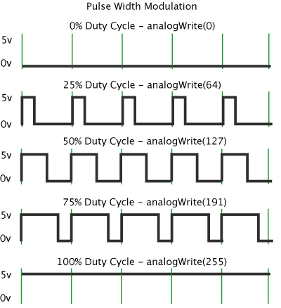



Adjust brightness using PWM
Certain pins on the arduino can output square waves of varying duty cycle. These pins are marked PWM.
By rapidly switching the LED on and off, we can fool the eye into thinking that the LED is varying in brightness.
The duration of ON time is called pulse width.

Slide 5
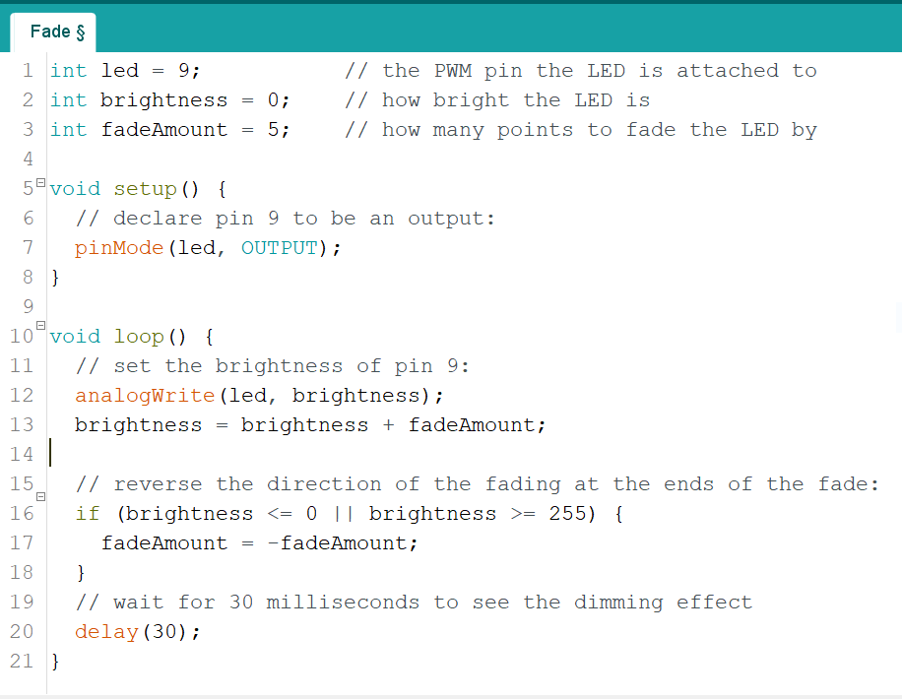
How do we use PWM?
The function to use is :
analogWrite(pin , val);
Where val is a number between 0 and 255.
This varies the duty cycle of the pulse, which varies the brightness of the LED

Slide 6
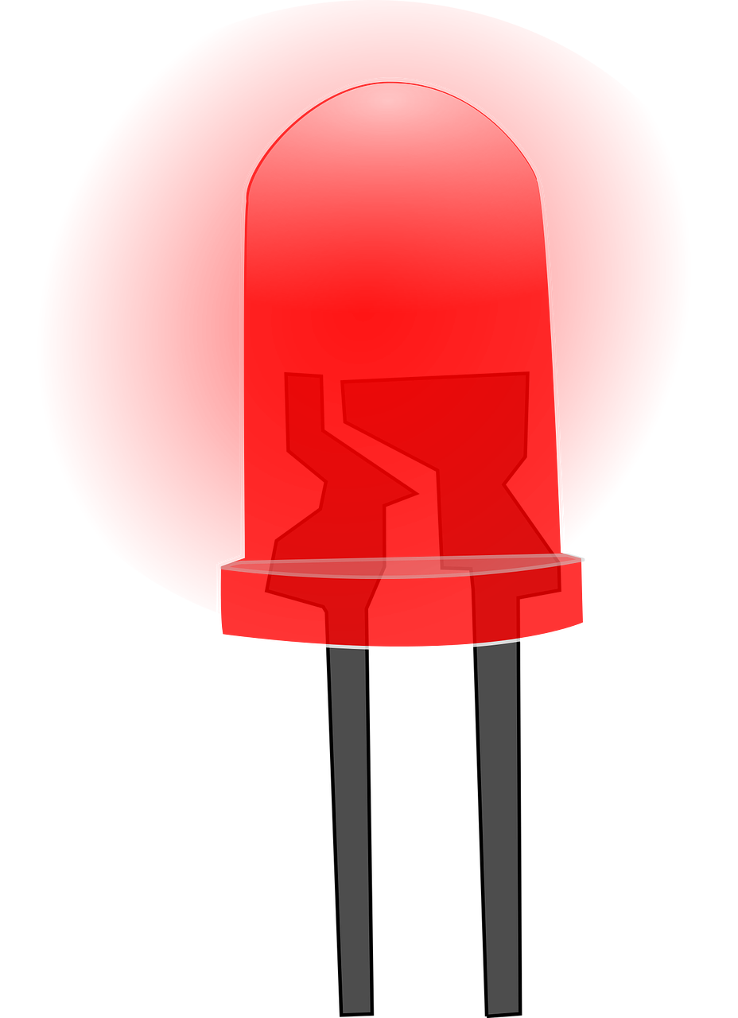
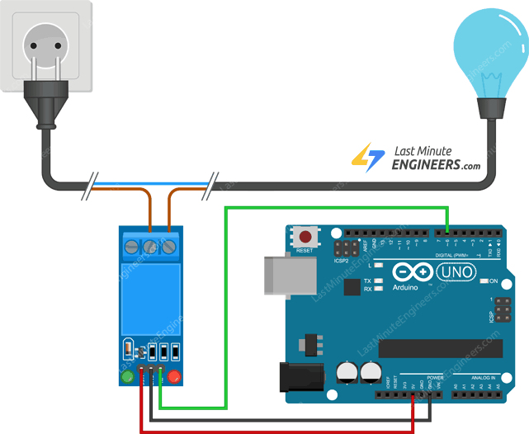
Using High Power LEDs with arduino
LED Driver
Small LEDs such as the ones we have been using now can be powered by the arduino pins.
The arduino pin can typically handle current upto 40mA
Any LED which draws more than 40mA should not be driven by the microcontroller.
The easiest ways to drive high loads are:
Using a transistor
Using a relay
Picture Credit: lastminuteengineers.com

Slide 7
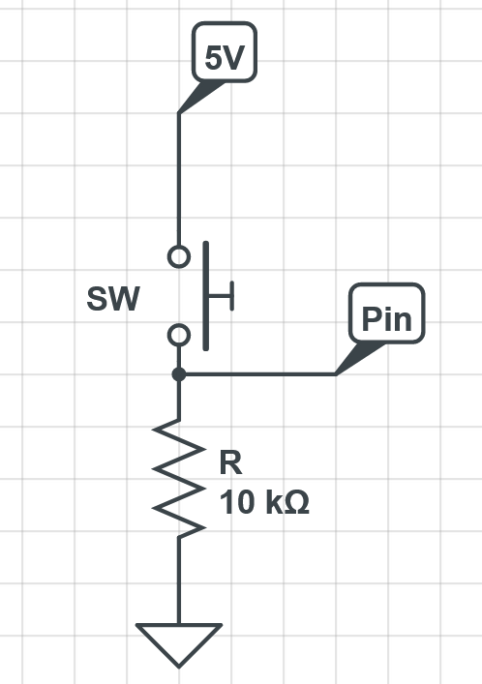
Buttons and arduino
Here, when the momentary switch is unpressed, the pin of the arduino is connected to ground through the resistor R, I.e the pin reads LOW.
When the switch is pressed, the pin is connected to 5V, I.e the pin reads HIGH.
While the theory is sound, we encounter a problem when implementing the circuit.
The momentary switch relies on two metal contacts touching each other. However, due to the mechanical nature of these switches, multiple transitions can occur even when you press the switch only once.
This fools the program into thinking that the button was pushed multiple times.

Slide 8
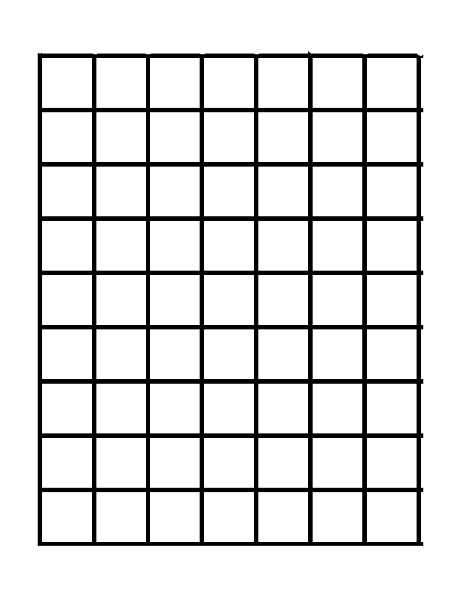
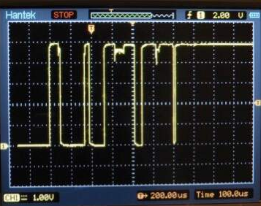
Button 'Bouncing'
Expected output at 'pin'
Actual output at 'pin'
5V
0V

Slide 9
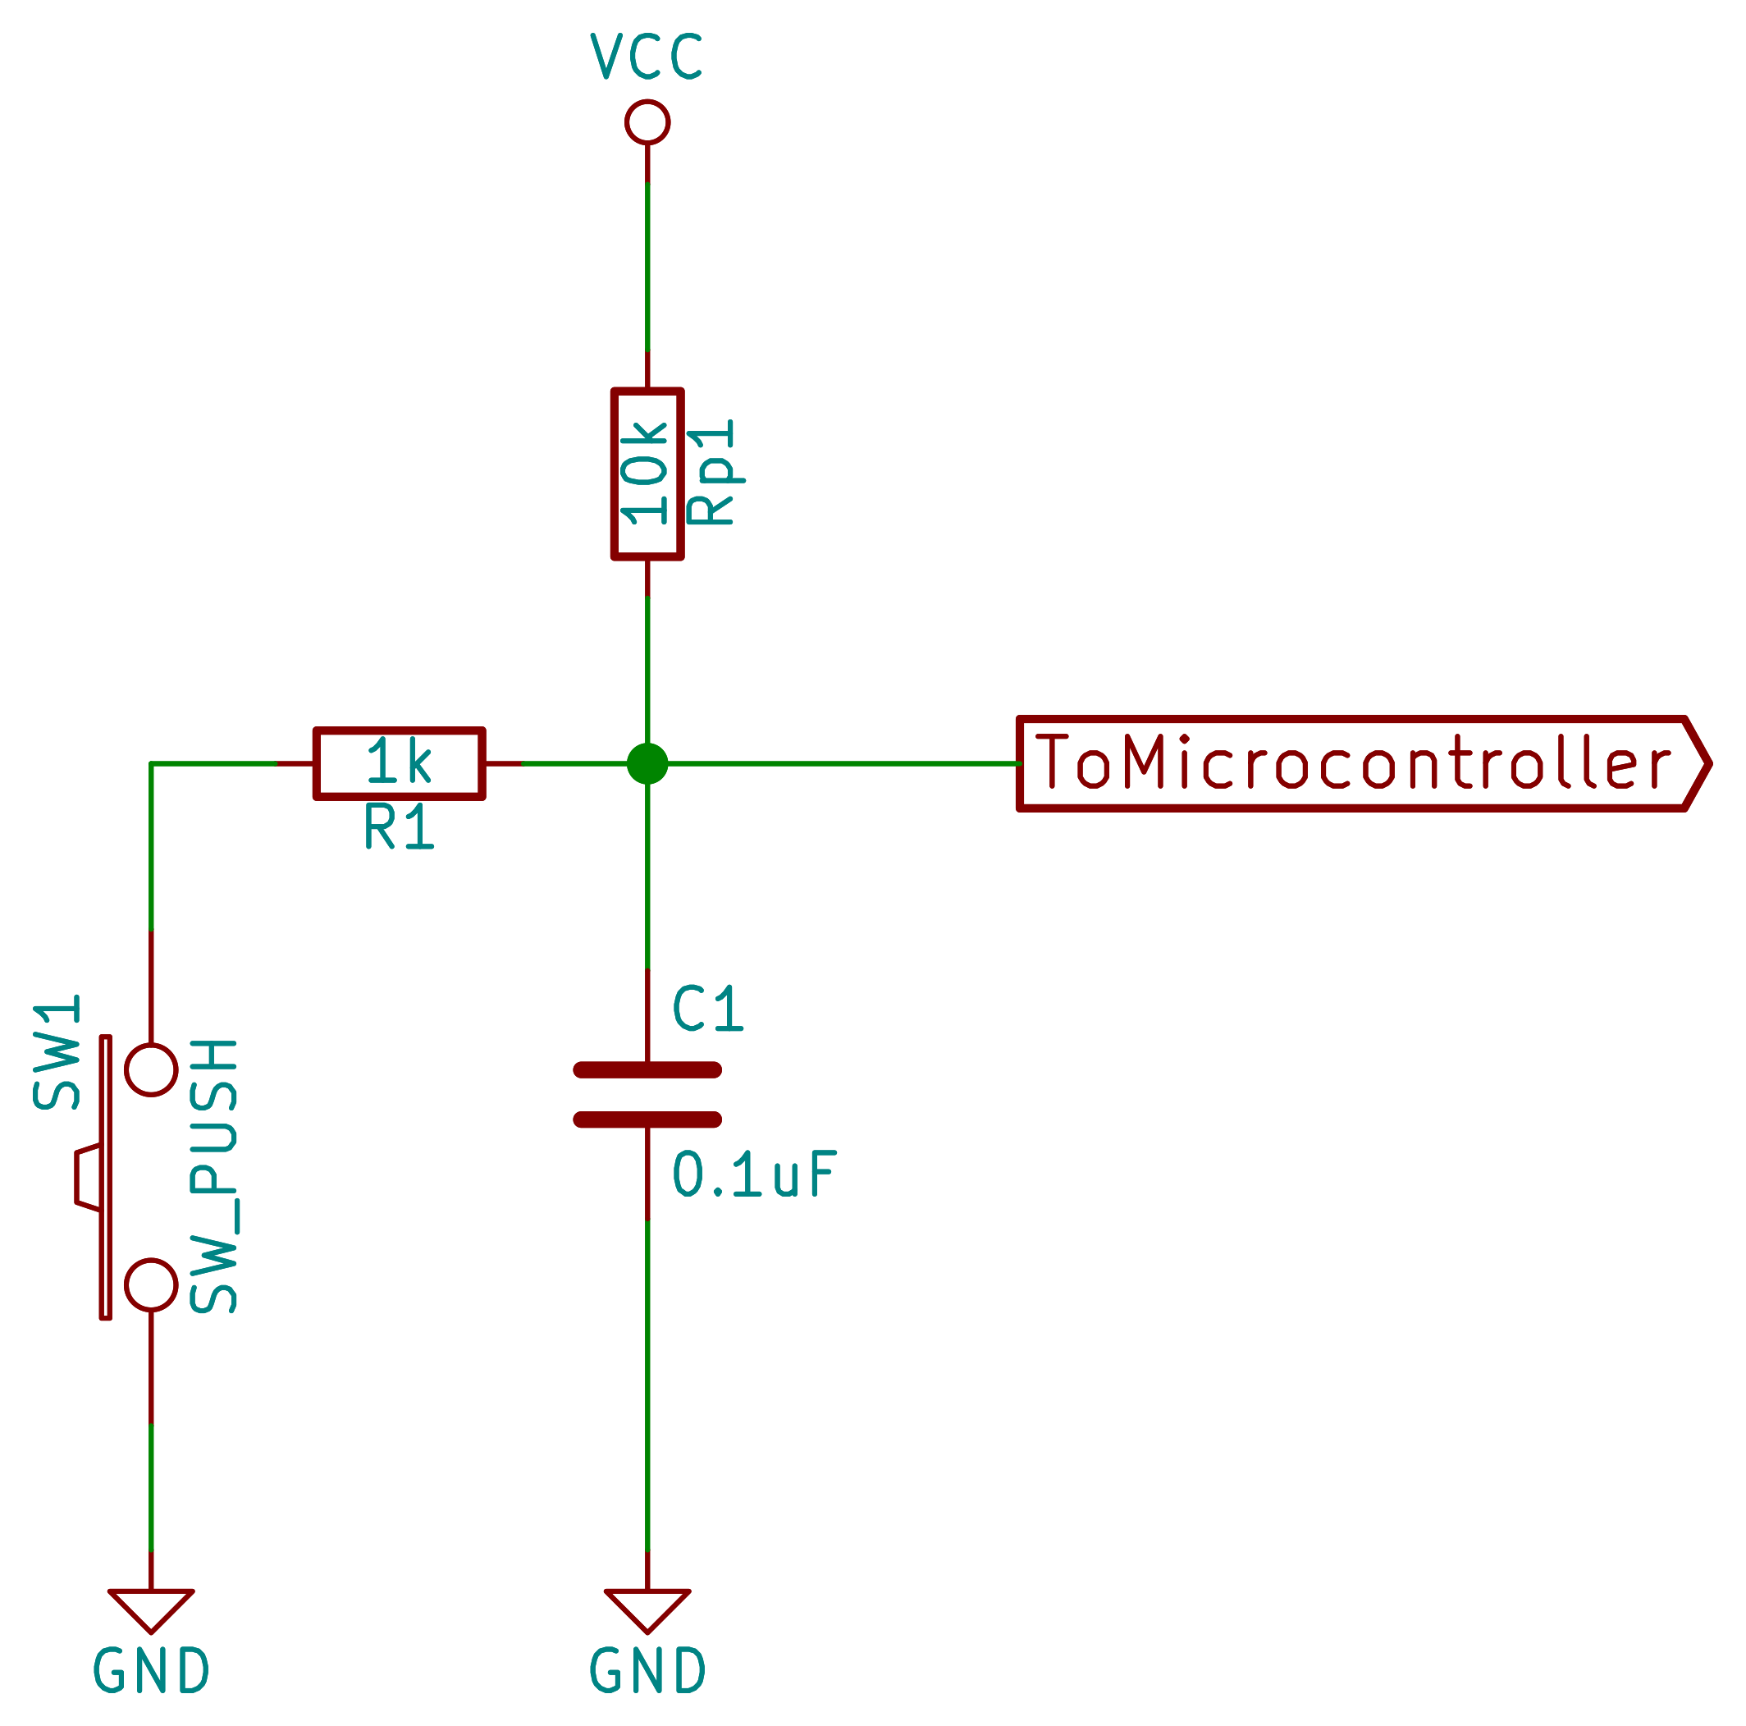
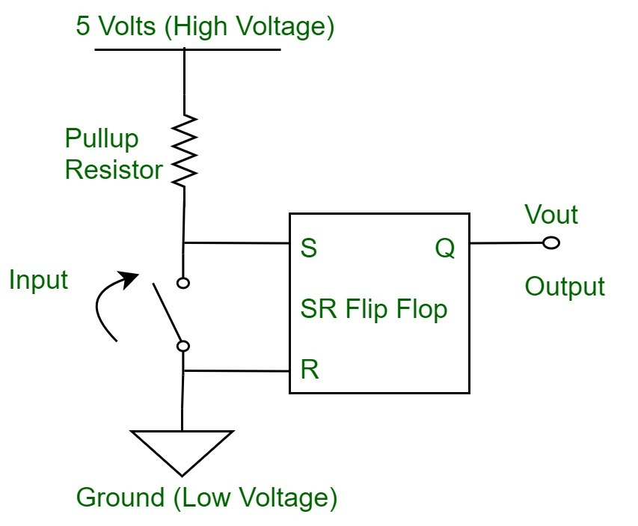
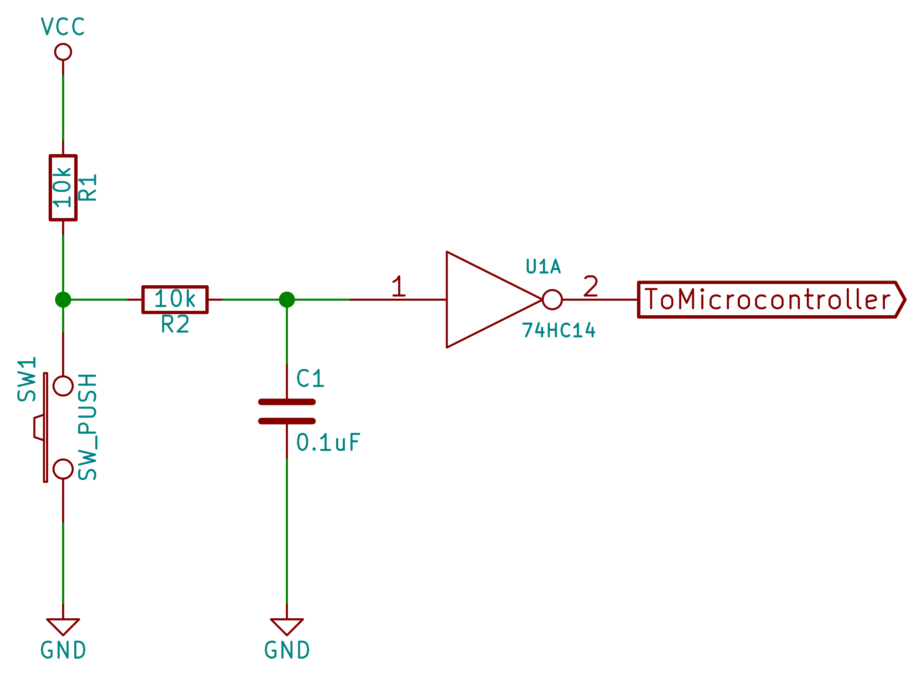
Fix it in Hardware!
Using a low pass filter
Using an SR flip-flop
Using a schmitt trigger
The time constant RxC should equal the bounce time

Slide 10
Fix it in software!
You can use code to 'debounce' the momentary switch. Here's how to goes:
For this to work, we should know the initial state of the button beforehand.
We should also keep track of the state of the button when it changes state.
Caution: It is tempting to use the delay() function to debounce the button. It is not recommended as it stops all other processes. The millis() function should instead be used.
Microcontroller looks for change in state
When change occurs, start Clock
Wait for predefined amount of time
Check state again
If prevState = currentState, switch was pressed
Otherwise, switch was not pressed
See: EP_debounce

Slide 11
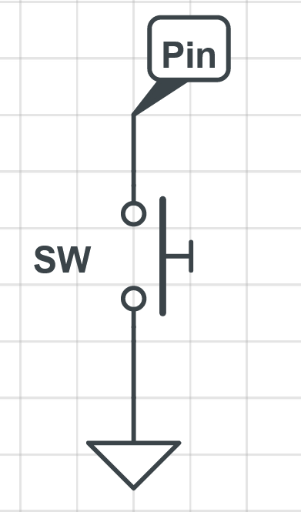
Buttons and arduino: A simpler approach
The input pins of the arduino have built in pullup resistors. These can be used to pullup the button to a HIGH state.
Instead of setting pin mode as
pinMode(pin , INPUT);
Use
pinMode(pin, INPUT_PULLUP);
When the button is unpressed, the pin of the arduino is connected to 5V, I.e HIGH. When button is pressed, the pin is connected to Ground, I.e LOW

Slide 12
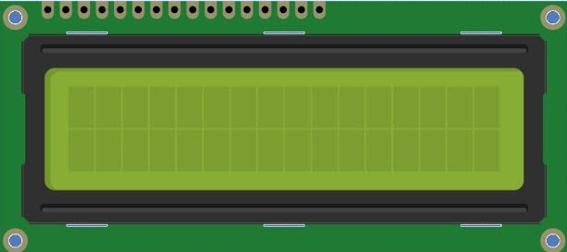
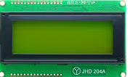
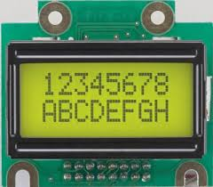
LCDs - Introduction
The humble liquid crystal display (LCD) is probably the most used display type with the arduino.
The LCD display available in the market are available in specifications such as 16x2, 16x1, 16x4 etc.
16 x 2
The LCD consists of 'cells'. Each cell displays a character. A 16x2 display has 32 'cells'. It can display 32 characters at any instant.
No. Of columns No. Of rows

Slide 13
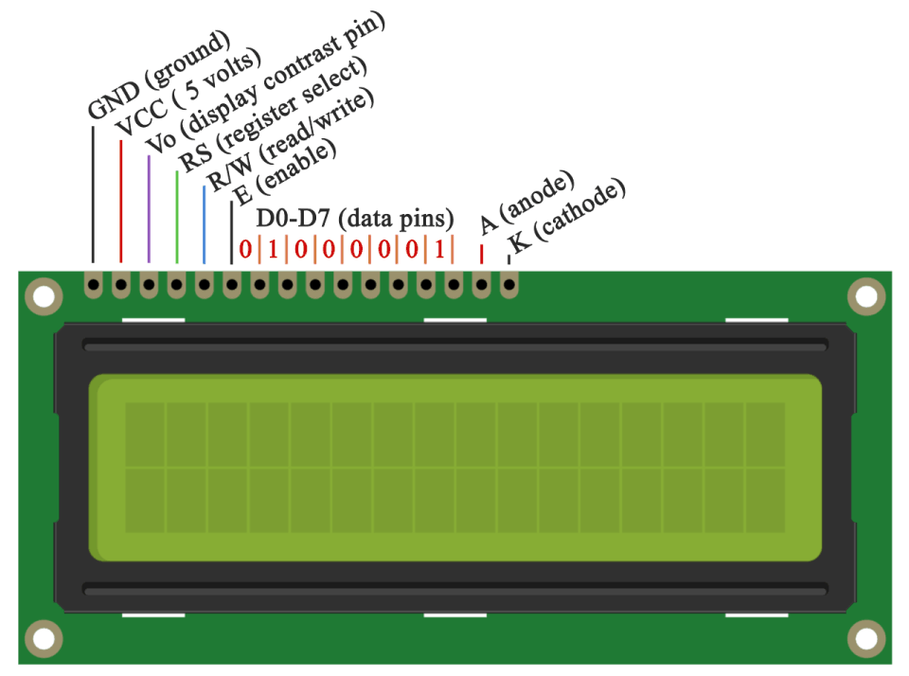
LCD pinout example : 16x2
Credits: HowToMechatronics.com

Slide 14
What does each pin do?
LCD pin | Function | Arduino connection
VSS/GND | Ground(-) | GND
VDD | +5V | +5V
V0 | Sets contrast | Connect to pot
RS | Register Select | Any pin
RW | Read/Write | GND
E | Enable | Any pin
D0 | Data input 0 | -
D1 | Data input 1 | -
D2 | Data input 2 | -
D3 | Data input 3 | -
D4 | Data input 4 | Any Pin
D5 | Data input 5 | Any Pin
D6 | Data input 6 | Any Pin
D7 | Data input 7 | Any Pin
A | Anode of backlight LED | +5V of external power supply
K | Cathode of backlight LED | GND of external power supply

Slide 15
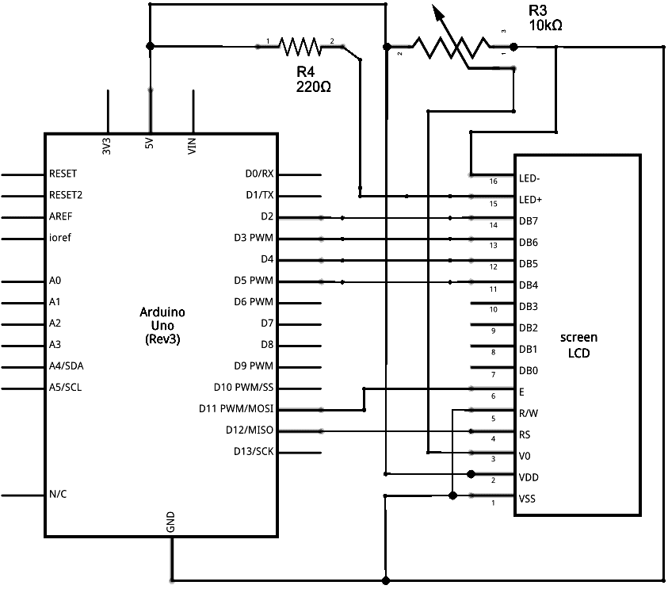
Connection to the arduino
Credits:
Arduino.cc

Slide 16
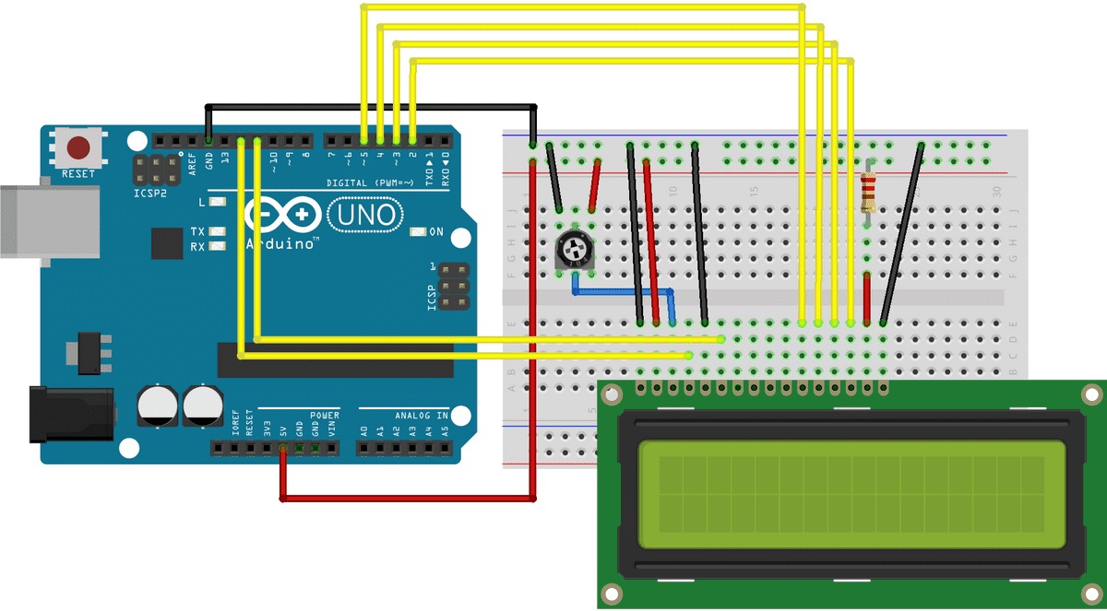
Connection to the arduino
Credits:
Arduino.cc

Slide 17
Setting up the LCD in the arduino evironment
Include the LiquidCrystal library
Create variable of type LiquidCrystal
Assign pin numbers
Initialize the LCD
Use the LCD!

Slide 18
Setting up the LCD in the arduino environment
TO | Function
Include the liquidCrystal library | #include <LiquidCrystal.h>
Create a variable of type LiquidCrystal | LiquidCrystal lcd(rs, enable, d4, d5, d6, d7) ; LiquidCrystal lcd(rs, rw, enable, d4, d5, d6, d7) ; LiquidCrystal lcd(rs, enable, d0, d1, d2, d3, d4, d5, d6, d7) ; LiquidCrystal lcd(rs, rw, enable, d0, d1, d2, d3, d4, d5, d6, d7);
Assign pin numbers | const int rs = 12, en = 11, d4 = 5, d5 = 4, d6 = 3, d7 = 2;
Initialize the LCD in void setup | lcd.begin (cols, rows);

Slide 19
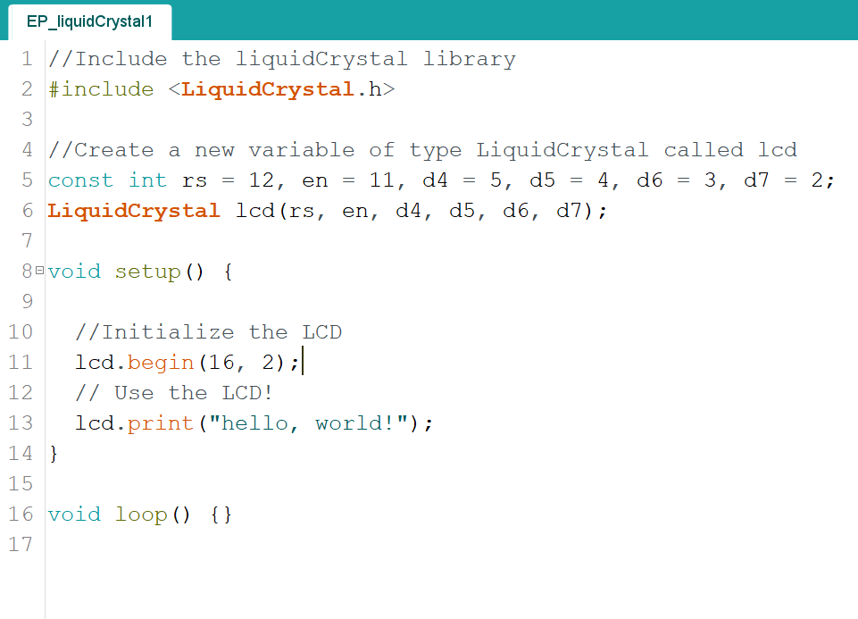
Setting up the LCD in the arduino environment
We have setup the LCD to work with the arduino. We can now start using it

Slide 20
Basic functions using the LCD
Function | Syntax | Argument
To clear the screen | lcd.clear() | Does not take any arguments
To set Cursor position | lcd.setCursor(col,row); | col : column row : Row
To display charcters on the lcd | lcd.print("Whatever"); | Type the text inside double quotes
To show or hide cursor | lcd.cursor(); lcd.noCursor(); | Does not take any arguments
To make cursor blink | lcd.blink(); lcd.noBlink(); | Does not take any arguments
 | 0 | 1 | 2 | 3 | 4 | 5 | 6
0
1
7 | 8 | 9 | 10 | 11 | 12 | 13 | 14 | 15

Slide 21
Scrolling using the LCD
Function | Syntax
Set scroll direction from left to right | lcd.leftToRight();
Set scroll direction from right to left | lcd.rightToLeft()
Scroll display one position left | lcd.scrollDisplayLeft();
Scroll display one position right | lcd.scrollDisplayRight();
Automatically scroll left to right | lcd.autoscroll();
Turn off automatic scrolling | lcd.noAutoscroll();

Slide 22
Creating Custom Characters
The LiquidCrystal library allows us to use create up to 8 custom characters such as smiley faces, hearts etc.
Each cell is made of a 5x8 matrix. We can manipulate each pixel to create custom characters.
For example the data for the this custom character is:
B00000,
B01010,
B00000,
B00000,
B10001,
B01010,
B00100,
B00000,

Slide 23
Creating Custom Characters
We put this data into an array like so:
byte smiley[8] = { B00000, B10001, B00000, B00000, B10001, B01110, B00000, };
We can now use
lcd.createChar(num, data);
To create a custom character
For example,
lcd.createChar(0, smiley);
Creates a character using the data available is the array 'smiley'
This character is stored in the RAM of the LCD and can be addressed by using byte(0).

Slide 24
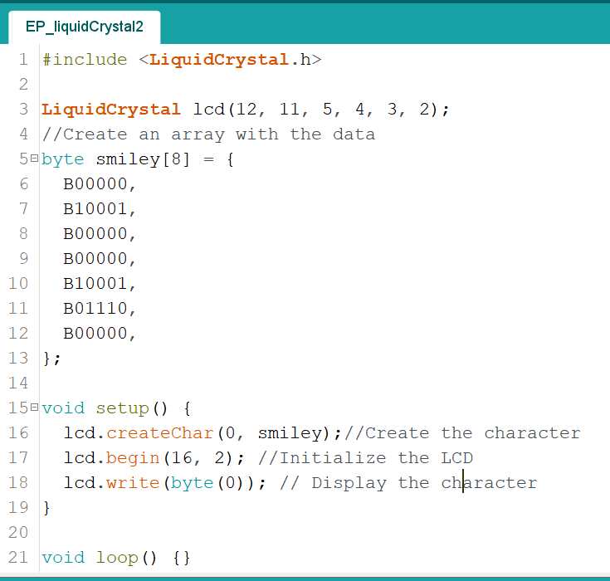
Creating Custom Characters

Slide 25
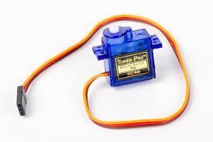
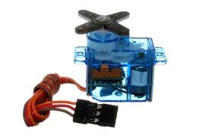
Servo motor and arduino
A servo is a motor with feedback.
Due to this we can accurately set the position at which the servo motor stops.
Most inexpensive servos have a range of either 180° or 270°.
The Servo motor has three wires:
+5V
GND
Signal

Slide 26
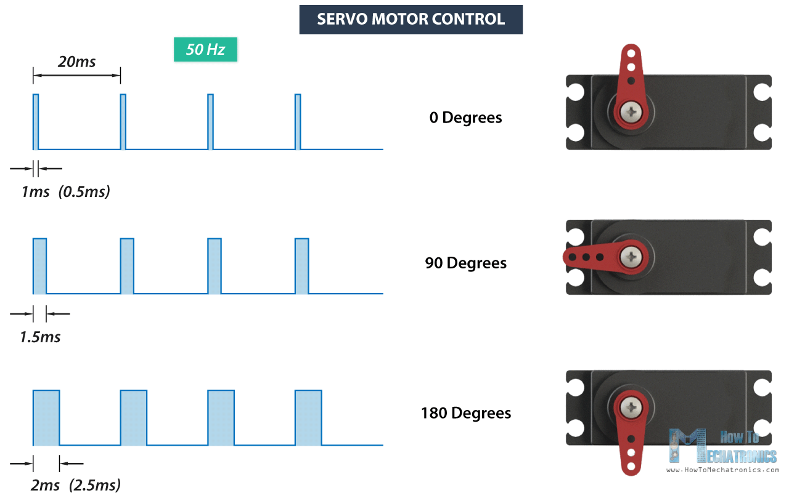
Controlling the servo
The position of the servo is controlled by feeding a square wave input to the signal pin of the servo motor.
The pulse width of the square wave, I.e the amount of time the square wave is HIGH, will determine the position of the servo.
An example of a servo with a span of 180° is given here.

Slide 27
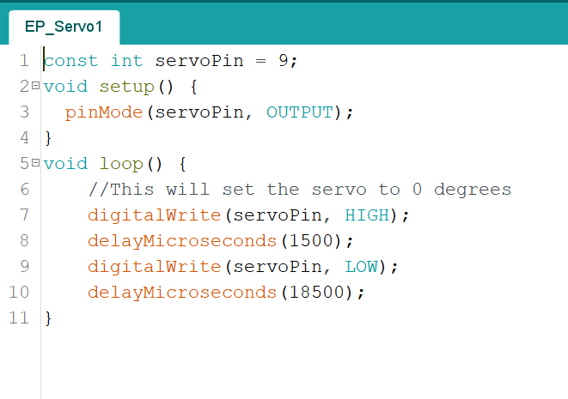
Controlling the servo
The PWM signal is of frequency 50Hz, I.e the time period is 20ms.
The ON time should vary between 1ms and 2ms. This can be executed in the arduino environment as shown.
But this is a very inefficient and cumbersome way of controlling the servo position.

Slide 28
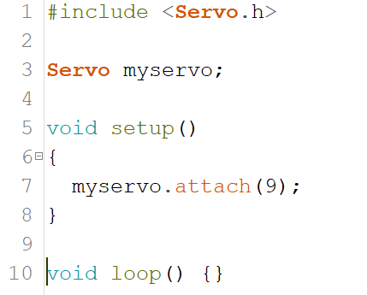
Controlling the servo
Thankfully, arduino has a library which makes controlling a servo very easy.
We setup the servo in the same way we setup the LCD. See right.
The servo library supports upto 12 servos
The power supply for the servo should NOT come from the arduino. An external power supply should be used.

Slide 29
Basic functions
Function | Syntax | Argument
Set the servo to a certain position | servo.write(angle) | The angle between 0 and 180
Set the servo to a certain position | servo.writeMicroseconds(mS); | The ON time of the pulse. Typically between 1000 and 2000 µS which is 1ms and 2ms
Read the position of the servo* | servo.read() | Spits out the angle of the servo- between 0 and 180
Detach the servo from its pin | servo.detach() | Takes no argument
*The servo does not have any mechanism to report its angle. Servo.read() simply reports the previous input to write().

Slide 30
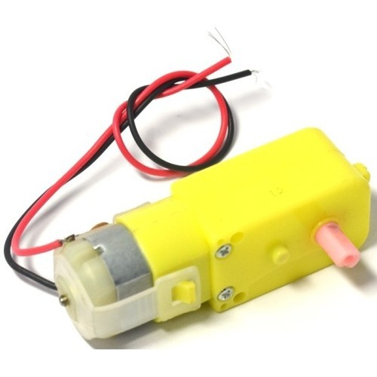
Using Motors with Arduino
Very often we are required to incorporate motion into circuits and the simplest way to do that is with the help of some motors.
Motors work on the principle of Fleming’s Left Hand Rule, where a current carrying conductor in a magnetic field experiences a magnetic field.

Slide 31
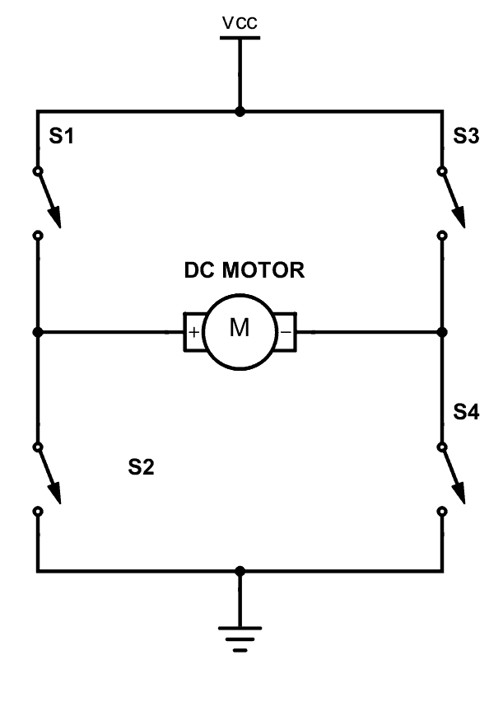
Using a H-Bridge
One thing to keep in mind when it comes to microcontrollers and motors, THEY MUST NEVER BE CONNECTED TO EACH OTHER DIRECTLY!
An Arduino can at most output only 250 mA from each of its pins but a motor requires a lot of current to start, this excessive current can damage the Arduino.
To get around this problem we use an external power supply and transistors as switches to control the power to the motor.
One such widely used design is a H-Bridge.

Slide 32
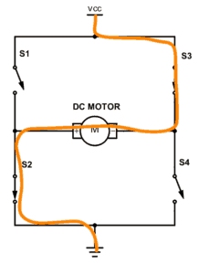
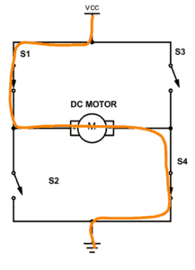
H-Bridge
A DC motor spins either backward or forward, depending on how you connect the plus and the minus.
If you close switch 1 and 4, you have plus connected to the left side of the motor and minus to the other side. And the motor will start spinning in one direction.
If you instead close switch 2 and 3, you have plus connected to the right side and minus to the left side. And the motor spins in the opposite direction.

Slide 33
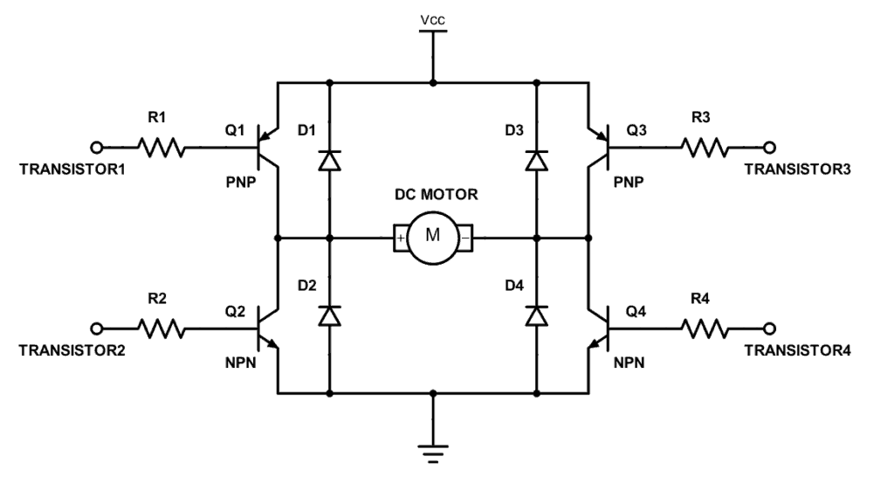
Adjust speed using PWM
This is the actual circuit inside the IC.
By adding another switch at VCC and turning it ON and OFF at different frequencies, we can adjust the speed of the motor.
This pin is also called the Enable pin and is controlled with PWM signals to vary the speed.

Slide 34
Interrupts and arduino
Interrupts stop the current work of Arduino such that some other work can be done.
The main program is running and performing some function in a circuit. However, when an interrupt occurs the main program halts while another routine is carried out. When this routine finishes, the processor goes back to the main routine again
Most Arduino designs have two hardware interrupts (referred to as "interrupt0" and "interrupt1") hard-wired to digital I/O pins 2 and 3, respectively.

Slide 35
Interrupts (example)
int pin = 2; //define interrupt pin to 2
volatile int state = LOW; // To make sure variables shared between an ISR
//the main program are updated correctly,declare them as volatile.
void setup() {
pinMode(13, OUTPUT); //set pin 13 as output
attachInterrupt(digitalPinToInterrupt(pin), blink, CHANGE);
//interrupt at pin 2 blink ISR when pin to change the value
}
void blink() {
//ISR function
state = !state; //toggle the state when the interrupt occurs
}
void loop() {
digitalWrite(13, state); //pin 13 equal the state value
}

Slide 36
Some really helpful Youtube Channels
Andries Spiess
Ben Eater
Core Electronics
DroneBot Workshop
EEV Blog
ElectroBOOM
Great Scott
The 8-Bit Guy
Zack Freedman

